Slide 1
ISM 6136
Data Mining
Dr. Tim Smith

Slide 2
Agenda
More on model evaluation:
”Which is the best metric”
How do we evaluate multiclass models?
Decision Tree Pruning
The bias/variance tradeoff
The various ways we can prune a tree
Hyperparameter Tuning and k-fold cross validation

Slide 3
More on evaluating models

Slide 4
Review: Evaluating a binary classifier
Predicted
No
Predicted
Yes
TN
FP
Accuracy = (TP+TN)/(TP+TN+FP+FN)
Misclassification = 1 – Accuracy
Recall = TP / (FN + TP)
Precision = TP (FP + TP)
F1 = 2 * (precision * recall) / (precision + recall)
Actual
No
FN
TP
Actual
Yes

Slide 5
Review
Accuracy: Of all the predictions I made, how many were correct?
Precision: Of all the positive predictions I made, how many of them are truly positive?
Recall: Of all the actual positive examples out there, how many of them did I correctly predict to be positive?
F1: Harmonic mean of precision and recall; and provides a more balanced summation of a models performance.

Slide 6
Not all problems are binary classification…
 | Number of Targets | Target Cardinality
Binary Classification | 1 | 2
Multiclass classification | 1 | >2
Multilabel classification | >1 | 2
Multiclass-multioutput classification | >1 | >2

Slide 7
Binary Classification
1 target variable that has a cardinality of 2
Easiest to interpret
Simplest of the classification models to evaluate
Examples:
Will a customer take a loan or not
Does a person have a disease or not
Is an email spam or not

Slide 8
Multi-class (aka Multinomial) classification
1 target variable that has a cardinality > 2
Confusion matrix is more complex
Many classification modeling techniques (i.e.. K-NN and decision trees) support multi-class:
Therefore do not require any special transformation or processing:
Not all classification modeling techniques support multi-class
These include logistic regression and support vector machines.
To compensate: split the multiclassification dataset into multiple binary classification datasets and fit a binary classifier.
Two approaches: One versus One (OvO) or One versus Rest (OvR)
Examples of these types of problems:
Which major will a college student choose
Which blood type does a person have
Which candidate will a person vote for

Slide 9
Multilabel Classification
> 1 targets with cardinality of 2 (0 or 1)
When we have two of more classes and we predict if an observation belongs to zero or more of these classes.
Generally approached using one of three strategies
Transform the problem into a multiclass problem using coding
Represent each class as a binary code – creating one class for each combination found
See sklearn’s “OutputCodeClassifier”
Transform the problem into a number of binary models (one-vs-one)
One binary classifier per pair of labels
See sklearn’s “OneVsOneClassifier”
Transform the problem into a multiclass problem (one-vs-rest)
Create one classifier per class – it exists or not
See sklearn’s “OneVsRestClassifier”
Once transformed, the problem is handled using binary or multiclass techniques.
Examples:
Reviews on twitter – customer refers to price, quality and/or service.
Movies – classified as drama, comedy, romantic and/or adventure.

Slide 10
Multiclass multi-output classification
>1 targets variable with cardinality > 2
Best handled by modeling techniques/algorithms that can handle this situation:
Out of scope for us in this course, but be aware of this type of problem.
For examples, see
https://www.kaggle.com/code/depture/multiclass-and-multi-output-classification
https://medium.com/@cactuscode/multioutput-multiclass-classification-b0737a0693ec

Slide 11
OvR
One-vs-rest is a method for using binary classification algorithms for multi-class classification.
OvR approach splits the multi-class dataset into multiple binary classification problems.
Example: Predicting red, blue, green or yellow:
Binary classification problem 1: red vs [blue, green, yellow]
Binary classification problem 2: blue vs [red, green, yellow]
Binary classification problem 3: green vs [red, blue, yellow]
Binary classification problem 4: yellow vs [red, blue, green]
A binary classifier is then trained on each binary classification problem and predictions are made using the model that is the most confident.

Slide 12
OvO
Like one-vs-rest, one-vs-one splits a multi-class classification dataset into binary classification problems.
One-vs-one approach splits the dataset into one dataset for each class versus every other class.
Example: Predicting red, blue, green or yellow:
Binary classification problem 1: red vs. blue
Binary classification problem 2: red vs. green
Binary classification problem 3: red vs. yellow
Binary classification problem 4: blue vs. green
Binary classification problem 5: blue vs. yellow
Binary classification problem 6: green vs. yellow
Each binary classification model may predict one class label and the model with the most predictions or votes is predicted by the one-vs-one strategy.

Slide 13
Let’s look at a multi-class classifier
k-NN and Decision Trees can easily handle a multi-class classification problem.
By default, Sklearn uses a OvR approach when calculating multi-class evaluation metrics for models that are not inherently multiclass (see here for more detail)
These are easier to interpret and use, so it’s a good default
Let’s use k-NN, and demonstrate the fitting and evaluation of a multi-classifier model (k-NN is inherently multiclass):
c06_2_multiclass_scoring_metrics.ipynb

Slide 14

Assessing a multi-classifier
The confusion matrix is more difficult to interpret:
Predicted
1
2
3
23 | 0 | 0
1 | 18 | 0
0 | 0 | 12
1
What are FN’s vs FP’s?
How can we calculate accuracy, precision, recall and f1 scores?
2
Actual
3

Slide 15
Assessing a multi-classifier – One Class
We can calculate the scores for each class
Let’s look at ‘red’ class
Total = 82
Total TP = 23
Total TN = (18+2)+(7+12) = 39
Total FP = (1+6) = 7 # vertical
Total FN = (4+9) = 13 # horizontal
Accuracy = (23+39)/82 = 0.7561
Precision = 23/(23+7) = 0.7667
Recall = 23/(23+13) = 0.6389
F1 = 2* (0.7667* 0.6389)/(0.7667 + 0.6389) = 0.6970
Average=‘micro’
Predicted
red
blue
green
23 | 4 | 9
1 | 18 | 2
6 | 7 | 12
red
blue
Actual
green

Slide 16
Assessing a multi-classifier - Micro
A micro-average will aggregate the contributions of all classes to compute the average metric
Total = 82
Total TP = 23+18+12 = 53
Total FP = (1+6)+(4+7)+(9+2) = 29 # vertical
Total FN = (4+9)+(1+2)+(6+7) = 29 # horizontal
Accuracy = (23+18+12)/82 = 0.6463
Precision = 53/(53+29) = 0.6463
Recall = 53/(53+29) = 0.6463
F1 = 2* (0.6463 * 0.6463)/(0.6463 + 0.6463) = 0.6463
When evaluating multiclass classifiers using average=‘micro’….
Accuracy=Precision=Recall=F1
Average=‘micro’
Predicted
red
blue
green
23 | 4 | 9
1 | 18 | 2
6 | 7 | 12
red
blue
Actual
green

Slide 17
Assessing a multi-classifier - Macro
A macro-average focuses on one metric (i.e. f1score)
Calculate the metric for each class individually, then take the unweighted mean.
Let’s say:
f1red = 0.7
f1blue = 0.8
f1green= 0.9
F1macro = (0.7+0.8+0.9)/3 = 0.8
Average=‘macro’

Slide 18
Assessing a multi-classifier –Weighted
A macro-average focuses on one metric (i.e. f1score)
Calculate the metric for each class individually, then take the unweighted mean.
Let’s say:
f1red = 0.7, and there are 10 reds
f1blue = 0.8, and there are 12 blues
f1green= 0.9, and there are 14 greens
F1macro = ((0.7*10)+(0.8*12)+(0.9*14)) / (10+12+14) = 0.8111
Average=‘macro’

Slide 19
Assessing a multi-classifier
A few things to note:
In multiclass evaluation accuracy=recall=precision=f1 for ‘micro’ average
This will not be the case for a multi-label problem
Use micro-averaging score when there is a need to weight each instance or prediction equally.
Use macro-averaging score when all classes need to be treated equally to evaluate the classifier's overall performance with regard to the most frequent class labels.
Use weighted macro-averaging score in class imbalances (different instances related to different class labels).

Slide 20
Decision Tree Pruning (and hyper-parameter tuning)

Slide 21
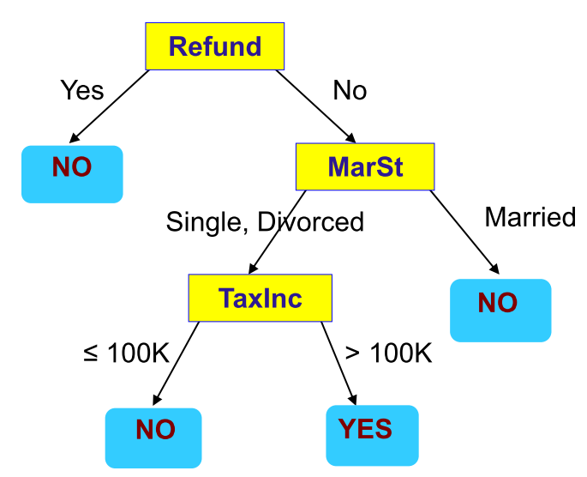
Decision Tree - review
Supervised Learning Model
Predictors/features/attributes as input
Predicted Output/Outcome can be checked with known result
Flowchart like Tree structure
Two types of Decision Tree:
Classification Tree (outcome is classification) ← this is our focus in this course
Regression Tree (outcome is continuous)
Root Node
Internal Nodes
Leaf Nodes

Slide 22
Potential Problems with DT’s
Overfitting
Tends to overfit data, reducing the performance of the model on future data.
Variance error
Small changes in data can yield a big change in the resulting tree

Slide 23
Classes of Prediction Error
With modeling, our object is to reduce model error (that is, error’s in the models predictions made on a given dataset)
Model error can be segmented into error we can correct for, and error we cannot.
Model Error = Reducible Error + Irreducible Error
Reducible Error is further segmented into Model Bias and Model Variance error:
Bias Error
Variance Error

Slide 24
Irreducible Error
This is error that cannot be reduced by any algorithm choice.
The error is caused by elements outside our control, such as statistical noise in the observations.
This is error can be introduced through the framing/context of the problem, or inherent in the data:
Unknown/unrecorded variables
Measurement error
Though we can work on squashing reducible error, irreducible error cannot be addressed with modeling.
Irreducible error will therefore always introduce an upper bounds to the performance of our model.

Slide 25
Model Bias Error
The bias is a measure of how close the model can capture the mapping function between inputs and outputs.
Low Bias: Weak assumptions regarding the functional form of the mapping of inputs to outputs.
High Bias: Strong assumptions regarding the functional form of the mapping of inputs to outputs.
A model with high bias is helpful when the bias matches the true but unknown underlying mapping function for the predictive modeling problem, but such models are not helpful if the bias does not match the underlying relationship.
i.e. Linear model
Easy to understand, quick to calculate/compute
Less flexible, and low predictive performance on complex problems that do not match underlying simplifying assumptions BUT, if the underling relationship is in fact linear, it will capture the mapping well.
This is also why we often spend a lot of time exploring and hypothesizing about the underlying relationship when using high biased models.

Slide 26
Variance Error
This is the amount/magnitude of change in predictions if different training data is used.
Low Variance: Changes in training data only result in small changes in prediction(s)
High Variance: Changes in training data result in large changes in prediction(s)
Examples of low-variance machine learning algorithms include:
Linear Regression, Linear Discriminant Analysis and Logistic Regression.
Examples of high-variance machine learning algorithms include:
Decision Trees, k-Nearest Neighbors and Support Vector Machines.
High variance models will perfectly match the relationship between and input and target in the training data, but will often perform poorly on new data.
We address this by limiting the model’s ability to fit the data (i.e. pruning in decisions trees), or utilizing ensemble techniques such as boosting and bagging.

Slide 27
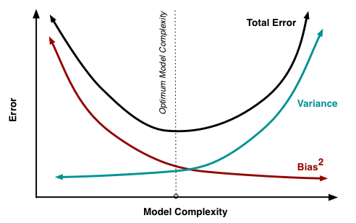
The Error ‘dilemma’…
There is no escaping the relationship between bias and variance in machine learning.
Increasing the bias will decrease the variance.
Increasing the variance will decrease the bias.

Slide 28
Managing Bias and Variance
Limiting bias:
The more assumptions you make about the relation (i.e. it’s linear, distribution is normal, etc.) the more you introduce bias (this isn’t necessarily bad, but can be if not applicable)
What is important is the performance of the model on the data you actually have
Limiting variance
Some modeling techniques (i.e. decision trees) exhibit a high degree of variance.
Pruning/constraining your model
Bagging and Resampling
Bagging (Bootstrap Aggregating) can reduce variance in model predictions
What about getting more data?
More data will help manage the problem of variance, but will not impact bias
Bias can only be changed by altering the modeling technique

Slide 29
Decision Trees: Bias and Variance
Decision trees exhibit…
low bias
Not impeded by strong assumptions/constraints
Will fit/model complex relationships
high variance
Small changes in the training set will results in large changes in predictions/model produced.

Slide 30
How to address these problems with DT’s
Approach 1: Pruning
Depth, Min Split size, Min information decrease, etc.
Approach 2: Use ensemble techniques
Random Forests
Boosted Trees

Slide 31
Hyper Parameter Tuning

Slide 32
Significantly increases computational cost in training models…
You could have many 100’s of thousands of combinations that sklearn will test.
GridSearchCV is an exhaustive search:
It will check every value given in your parameter ranges.
RandomizeSearchCV is a random search
It will randomly sample a given number of combinations of your parameter ranges.
Ideally you want to check a wide range of values using small incremental changes in the parameters.
In reality, this is often take too much time!
Common Strategy
Use RandomizedSearchCV to check a number of random samples of a wide range of parameter values.
Use GridSearch to check small incremental changes around the best values found with the RandomizedSearchCV.

Slide 33
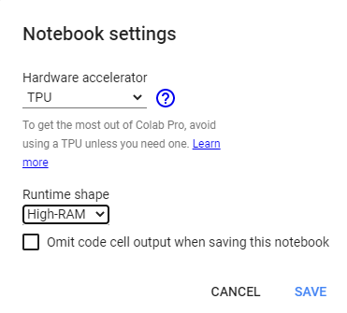
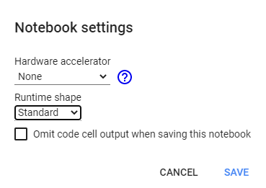
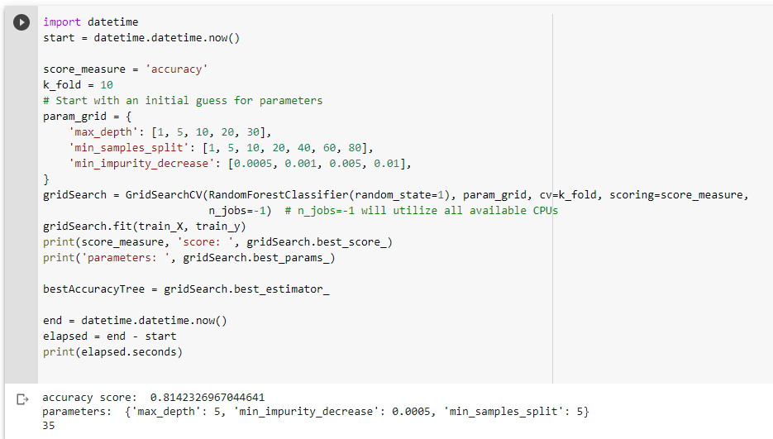
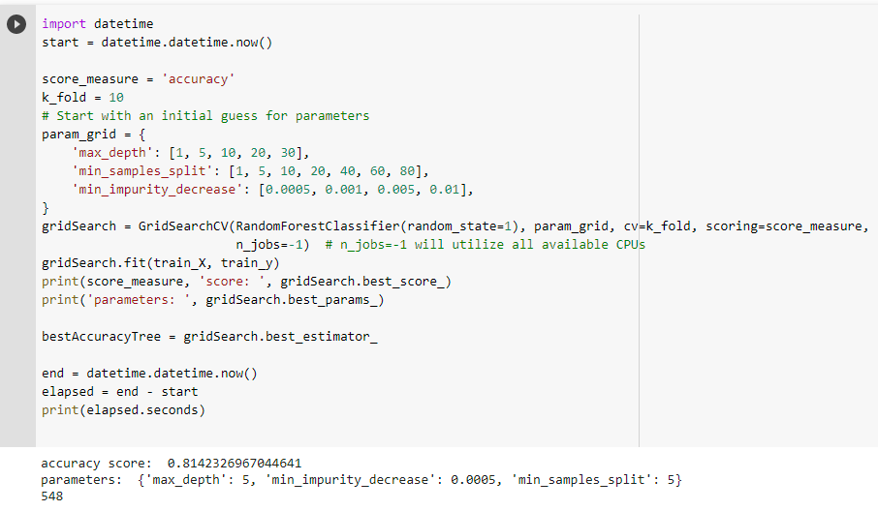
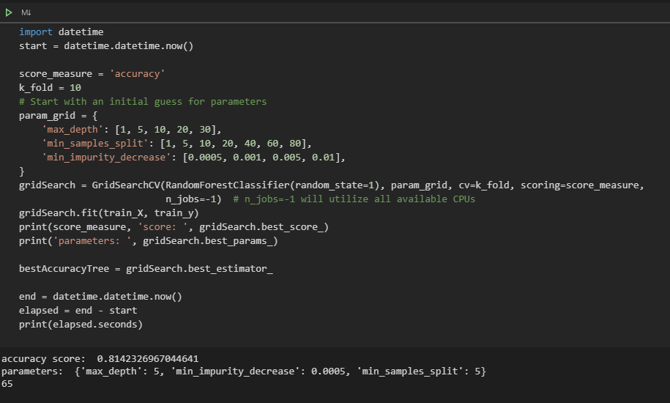
training with hyperparameter tuning takes time…
548
seconds
35
seconds
Laptop
Intel Core i9 10th generation
32 GB Ram
2080 Super Nvidia GPU
You will also experience “diminishing returns”, where it takes an increasingly large amount of computing time to achieve smaller gains in mode performance.
The degree you can ‘tune’ your model is dependent on time and computing resources.
65
seconds

Slide 34
Bagging and Boosting

Slide 35
Decision Trees: Bias and Variance
Decision trees exhibit…
low bias
Not impeded by strong assumptions/constraints
Will fit/model complex relationships
high variance
Small changes in the training set will results in large changes in predictions/model produced.

Slide 36
Ensembles
Ensembles involve combining a number of weaker models into an ensemble. The end result is a stronger aggregate model.
Two popular ensemble approaches are:
Bagging
Boosting

Slide 37
Bagging
Bagging is a method of converting a set of weak learners into strong learners.
Model 1: Misclassification of 0.49 (just better than a coin toss)
Model 2: Misclassification rate of 0.48
…
Model n: Misclassification rate of e
In ‘bagging’ we take a series of ‘weak learners’ average their predictions.

Slide 38
Bagging
Bagging :
A way to decrease the variance in the prediction by generating additional data for training from dataset using sampling techniques to create multi-sets of the original data
Bagging approach's:
Randomly select observations (with replacement) from the training data set.
This is called bootstrapping
Randomly select subset of features
Repeat this n iteration (default 100)
Aggregate the resulting trees by averaging the result from each tree in the set.
Bagging features:
Variance reduced
Note: Choosing all features, better individual trees but worse forest. Choosing less features, worse individual trees, but better forest. Three rules of thumb are found: N/3, root N, log base 2 (N + 1)

Slide 39
Boosting
Boosting is a method of converting a set of weak learners into strong learners.
How is this different than Bagging?
In ‘boosting’ we combine these ‘weak learners’ together in a a more sophisticated way.
Boosting involves creating a weak learner, then creating a new learner that includes information from the previous learner, and this process continues where each new learner has utilized information from the previous learner.

Slide 40
Boosting
Similar to bagging in that it created a random sample of observations and of features
Boosting differs in that it’s sequentially selected – that is, each tree is built using knowledge gained from previous tree. In contrast, random forests randomly select all data and build trees without an influence of other trees built.
There are multiple techniques used for boosting (i.e. Ada, Gradient Descent, and Extreme Boosting)

Slide 41
How to address the variance problem with DT’s
Approach 1: Pruning (use hyperparameter tuning)
Depth, Min Split size, Min information decrease, etc.
We saw this last class!
Approach 2: Use ensemble techniques
Bagging: RandomForest
Boosting: AdaBoost, GradientBoost, XGBoost
This is what we will look at today!

Slide 42
Random Forests and Boosted Trees

Slide 43
Random Forests
An “ensemble” machine learning method.
A Random Forest is a bunch of Decision Trees bundled together to make a decision.
Each individual tree ‘votes’ for the classification.
Majority vote determines the predicted class/value.

Slide 44
Results: Random “Forest” of trees
Random sample 1
Random sample 2
Random sample 3
Random sample 4
Random sample n
Bootstrapping
…
Doesn’t Take Loan
Takes Loan
Doesn’t Take Loan
Takes Loan
Takes Loan
Aggregating
Majority predict “Takes Loan” – Therefore, random forest model predicts “Takes Loan”
Bagging

Slide 45
Boosting
Ensemble Technique: Combines multiple weak learners to create a strong learner.
Iterative Process: Adjusts weights of instances in each round to give more importance to misclassified points.
Objective: To reduce bias and/or variance, thereby improving model accuracy.
Common Algorithms: AdaBoost, Gradient Boosting, XGBoost.
Applications: Classification, Regression, Ranking.

Slide 46
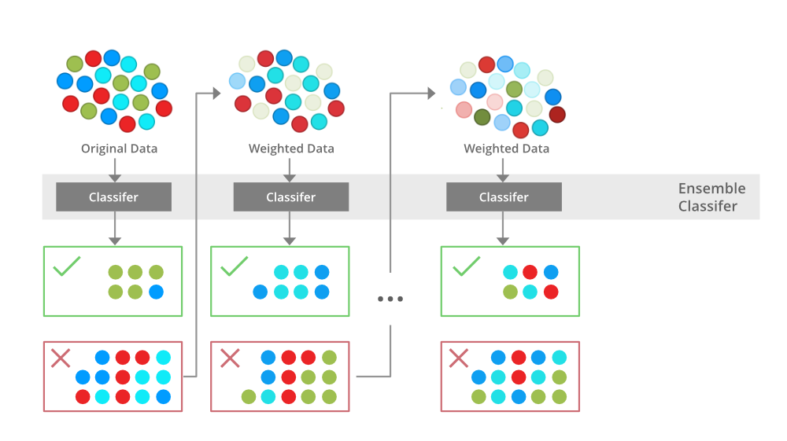
Generalized Boosting Approach to DTrees
+
+
+
Error
+
+
+
Iterations

Slide 47
XGBoost
Stands for Extreme Gradient Boosting
It’s an implementation of a gradient boosted decision tree
Its recently been used quite successfully in many competitive machine learning events.
Key tuning parameters are:
n_estimators (how many models to test)
early_stopping_rounds (stop if incremental improvement does not meet minimum)
learning_rate (the incremental improvement targeted for each iteration – smaller numbers tend to increase accuracy, but increase training time).

Slide 48
HyperParam tuning summary
Learning Algoritm | Classifier | Regressor | Key Tuning Parameters | Notes:
k-NN | KNeighborsClassifier | KNeighborsRegressor | k, metric, weights | try all odd k's from 1 through root N. Generally, leave weights to distance. Try all metrics.
 | RadiusNeighborsClassifier | RadiusNeighborsRegressor | radius, metric, weights | radius can take on many values - k's are much easier to work with. Try all metrics, generally leave weights to distance.
DecisionTree | DecisionTreeClassifier | DecisionTreeRegressor | criterion, max_depth, min_samples_split, min_samples_leaf, max_leaf_nodes, min_impurity_decrease | This is all about finding the best 'pruning' parameter settings.
RandomForest | RandomForestClassifier | RandomForestClassifier | n_estimators, criterion, max_depth, min_samples_split, min_samples_leaf, max_leaf_nodes, min_impurity_decrease | n_estimators (the number of trees) and the pruning of the tree are the biggest considerations.
AdaBoost | AdaBoostClassifier | AdaBoostRegressor | n_estimators, learning_rate, loss | generally, leave loss function to default
GradientBoosting | GradientBoostingClassifier | GradientBoostingRegressor | loss, learning_rate, n_estimators, subsample, criterion | generally, leave loss function to default. If subsample is set (0 to <1.0) then this is getting into stochastic gradient decent and better to use that model.
XGBoost | XGBClassifier | XGBRegressor | n_estimators, max_depth, max_leaves, grow_policy, learning_rate, gamma (min_split_loss) | Focus on how many weak learners and tree pruning parameters.

Slide 49
Pickling

Slide 50
Pickle is a Python module used for serializing and de-serializing Python objects. It can be used to save and load machine-learning models.
To save a model using Pickle, import the Pickle module and call the dump function with the model and the file name.
import pickle
with open('filename.pkl', 'wb') as f:
pickle.dump(model, f)
To load the saved model, you need to import the pickle module and call the load function with the file name.
import pickle
with open('filename.pkl', 'rb') as f:
model = pickle.load(f)

Slide 51
Happy Learning!

